Slide 1

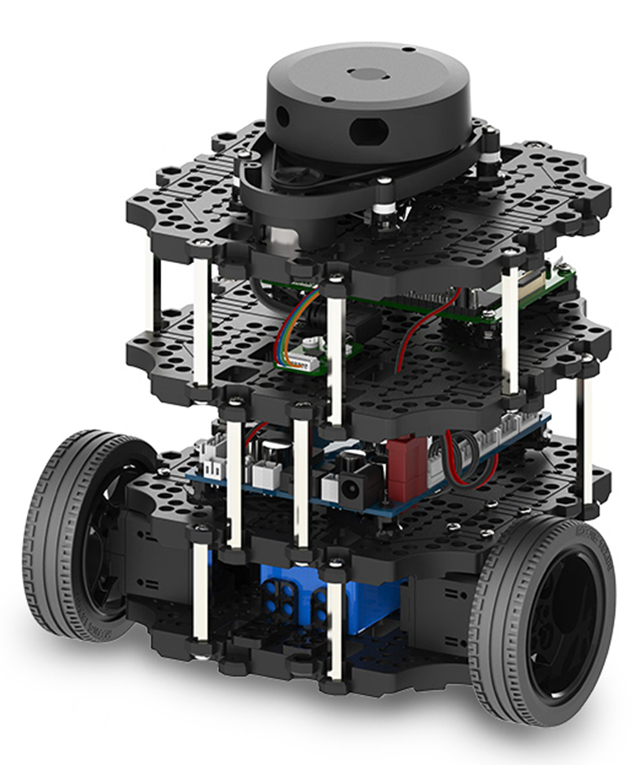
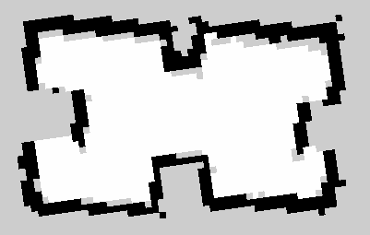
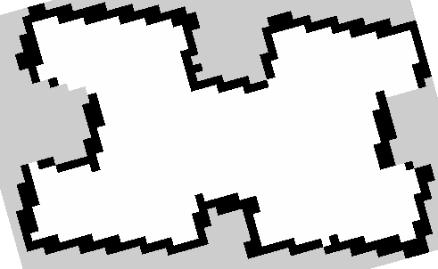
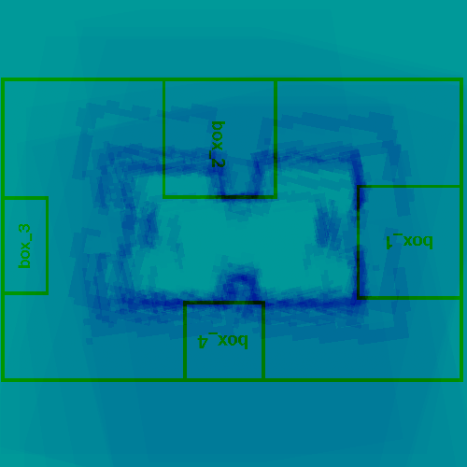
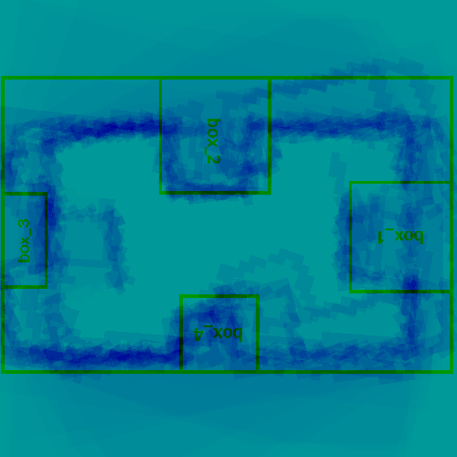
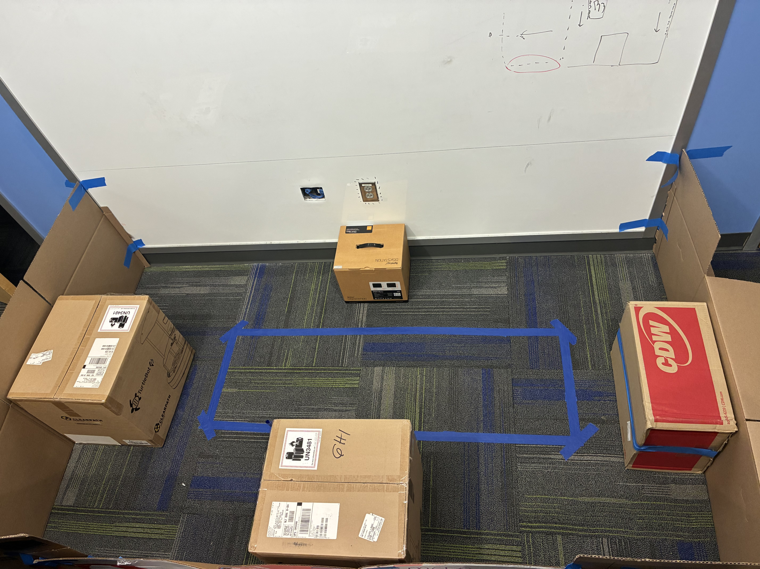
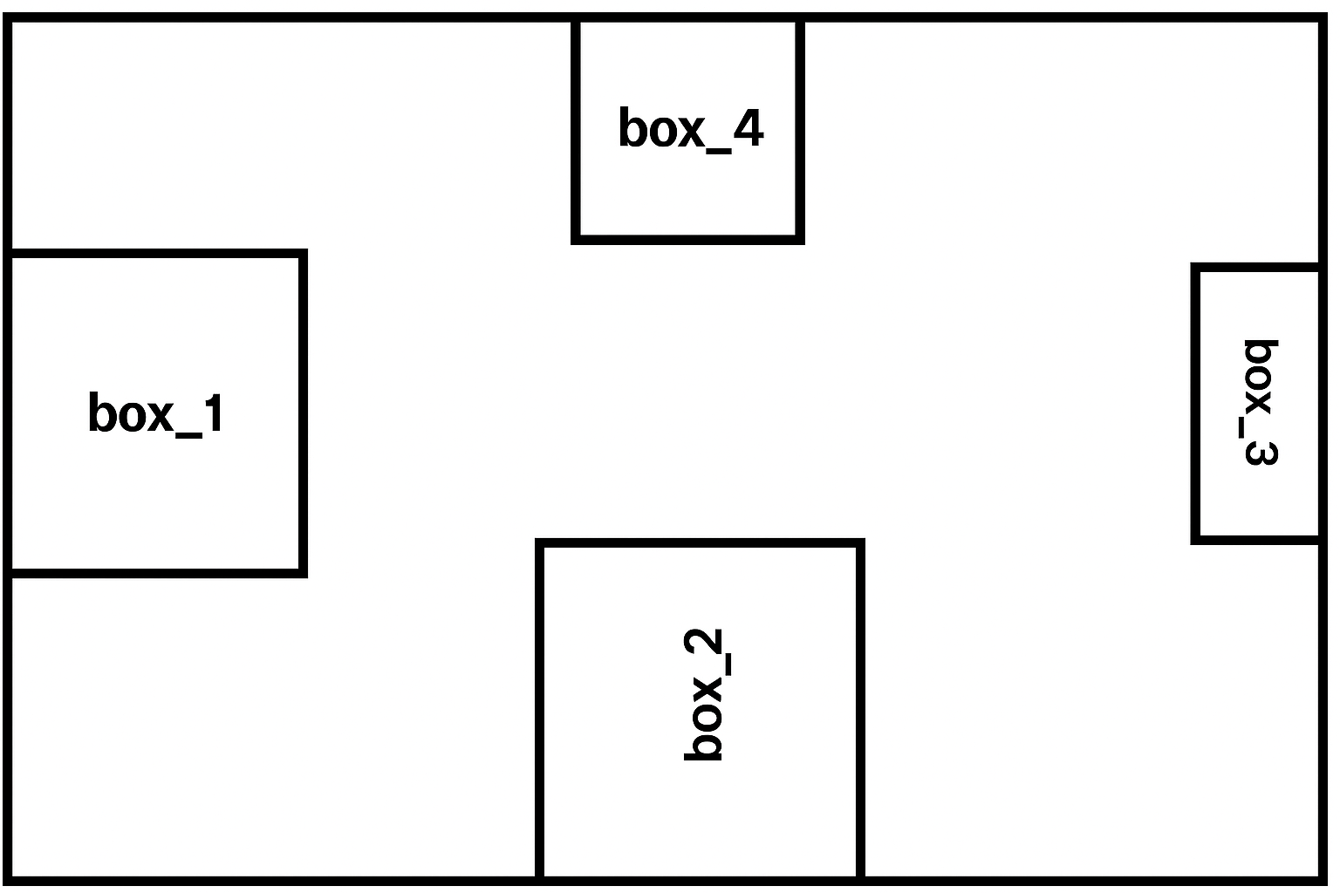
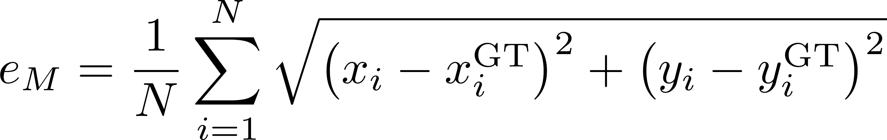
A Comparative Study of SLAM Algorithms
for Robot Operating System
Stenneth Swaby
Department of Computer Science, The College of New Jersey
Mentor: Dr. Sejong Yoon
MOTIVATION
  Simultaneous Localization and Mapping (SLAM) is a useful algorithm for robot navigation and mapping of the environment at the same time
  Improving SLAM precision supports advanced applications such as autonomous exploration and loop-closure correction in dynamic environments
  Two popular SLAM algorithms, SLAM Toolbox [2] and Cartographer [3] produce different quality map under identical conditions, affecting localization and navigation
METHODOLOGY
Both algorithms were configured using the default software setup from the original authors [1, 2]
Using each algorithm, the real TurtleBot was driven over predefined path at the speed of 0.01 m/s
Tests were performed 10 times in the same maze environment to ensure repeatability and gauge variance for each algorithm
All saved maps were resized to a fixed pixel dimension (500 by 500 pixels) to maintain consistent scaling
Image registration technique was used to overlay maps and visually align them for direct qualitative comparison
The program also computed the map error by quantifying pixel-level deviations between the generated SLAM maps
Following [4], we measured the average Euclidean distance between each map point and its corresponding ground-truth point
In addition to raw error, we also report Mean Squared Error (MSE), Root Mean Squared Error (RMSE), and Pearson’s correlation coefficient vs. ground truth
RESULTS
 | Cartographer |  | SLAM Toolbox
 | Error (px) | Error (cm) | Error (px) | Error (cm)
Mean | 25.227 | 126.134 | 19.294 | 96.468
Variance | 5.517 | 137.918 | 7.207 | 180.167
MSE | 641.909 | 16047.729 | 379.448 | 9486.196
RMSE | 25.336 | 126.680 | 19.479 | 97.397
Correlation | 0.246 |  | 0.169
BACKGROUND/PRIOR WORKS
  Li & Zhu (2024) evaluated three 2D LiDAR SLAM algorithms Hector, GMapping, and Cartographer n simulated orchard environments using Gazebo
    Cartographer achieved the best localization and mapping accuracy (≈ 8 cm error at 4 cm resolution), but required more CPU and memory
    Performance metrics: Localization error RMSE, Mapping error MAE, CPU and memory usage
Scale: 5 cm / px
In general, SLAM Toolbox outperformed Cartographer, but Cartographer yielded smaller variance across multiple runs and higher correlation to the ground truth
Cartographer
SLAM Toolbox
DISCUSSION
TurtleBot3 with ROS2 provide an ideal testbed for evaluating SLAM algorithm accuracy and reliability in real-world robotics
The lower average map error produced by SLAM Toolbox means the robot’s perceived environment was physically closer to the true maze geometry
SLAM Toolbox’s performance suggests stronger handling of local sensor noise and small-scale geometric deviations
Cartographer may smooth map features more aggressively, reducing noise but also increasing systematic drift in constrained environments like the maze
PROBLEM FORMULATION
This study compares Cartographer and SLAM Toolbox to determine which SLAM algorithm generates more accurate and consistent maps under identical conditions
Although both are widely used for autonomous navigation and mapping, performance differences arise from sensor noise, environment geometry, and algorithm design
A controlled maze environment with fixed ground-truth dimensions was used to ensure fair testing and repeatable conditions
The experiment quantifies mapping accuracy, reliability, and structural fidelity, identifying which algorithm provides superior geometric precision for the TurtleBot 3 platform
Cartographer
SLAM Toolbox
REFERENCES
ROBOTIS. (n.d.). TurtleBot3 quick start guide. ROBOTIS e-Manual. Retrieved November 2, 2025, from https://emanual.robotis.com/docs/en/platform/turtlebot3/quick-start/
SLAM Toolbox https://github.com/SteveMacenski/slam_toolbox
Google. (2016). Cartographer & cartographer_ros (Version 1.0) [Computer software]. https://github.com/cartographer-project
Li, Q., & Zhu, H. (2024). Performance evaluation of 2D LiDAR SLAM algorithms in simulated orchard environments. Computers and Electronics in Agriculture, 221, 108994. https://doi.org/10.1016/j.compag.2024.108994
Test Environment
Model Environment
Presented at Celebration of Computing, December 2025

